Slide 1

A
Presentation
on
Project Topic – ELECTRIC VOTING MACHINE
Presented By: PRATIK KUMAR DASH
Group No: 08
Mr. Name- PRATIK KUMAR DASH Registration No: 230301120095
Mr. Name- RITIKRUPAM NANDA Registration No: 230301120072
Mr. Name- SAI SUBHAM SAHOO Registration No: 230301120084
Mr. Name- DIBYAJYOTI SAHOO Registration No: 23030112078
Guided By: Mr. Satyananda Swain.
Asst. Prof., Department of CSE, CUTM, BBSR.
May 3, 2024
DEPARTMENT OF COMPUTER SCIENCE & ENGINEERING
SCHOOL OF ENGINEERING AND TECHNOLOGY, CUTM, BHUBANESWAR, ODISHA

Slide 2
Contents: 1. Abstract 2. Introduction: Problem Statement 3. Objectives 4. Hardware and Software Requirements 5. Design(Logic Used) 6. Code Samples 7. Result/Output (Snapshots) 8. Advantages and Limitations 9. Future Scope 10. Conclusion 11. References
DEPARTMENT OF COMPUTER SCIENCE & ENGINEERING
SCHOOL OF ENGINEERING AND TECHNOLOGY, CUTM, BHUBANESWAR, ODISHA

Slide 3
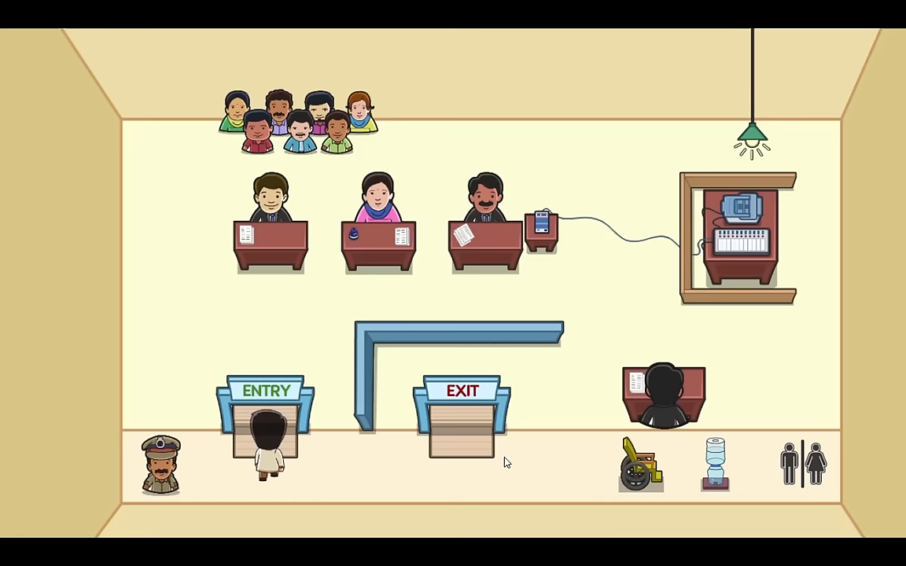
Abstract
Electronic voting machines (EVMs) make voting faster and easier, but they have security and accessibility issues. We need to keep improving them to make elections fair and inclusive for everyone.
Process :
step 1 - give your personal identity
Step 2 - Mark with a strong ink for security purpose for not give . Vote again
Step 3 - Give your voting id for verifying you are eligible or not.
Step 4 - Give your vote to right candidate and leave
DEPARTMENT OF COMPUTER SCIENCE & ENGINEERING
SCHOOL OF ENGINEERING AND TECHNOLOGY, CUTM, BHUBANESWAR, ODISHA

Slide 4

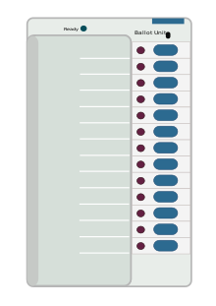
Introduction: Problem Statement
Introduction:
Electric voting systems, like Electronic Voting Machines (EVMs), revolutionize voting by replacing paper ballots with digital technology. They promise faster, more efficient elections.
Problems:
1. Security Concerns: EVMs face risks of hacking or tampering, compromising the integrity of elections.
2. Accessibility Issues: Some voters, especially those with disabilities or limited technology access, may struggle to use EVMs effectively, potentially disenfranchising them.
DEPARTMENT OF COMPUTER SCIENCE & ENGINEERING
SCHOOL OF ENGINEERING AND TECHNOLOGY, CUTM, BHUBANESWAR, ODISHA
Presented By: Mr. Name – Pratik kumar dash Registration No: 230301120095

Slide 5
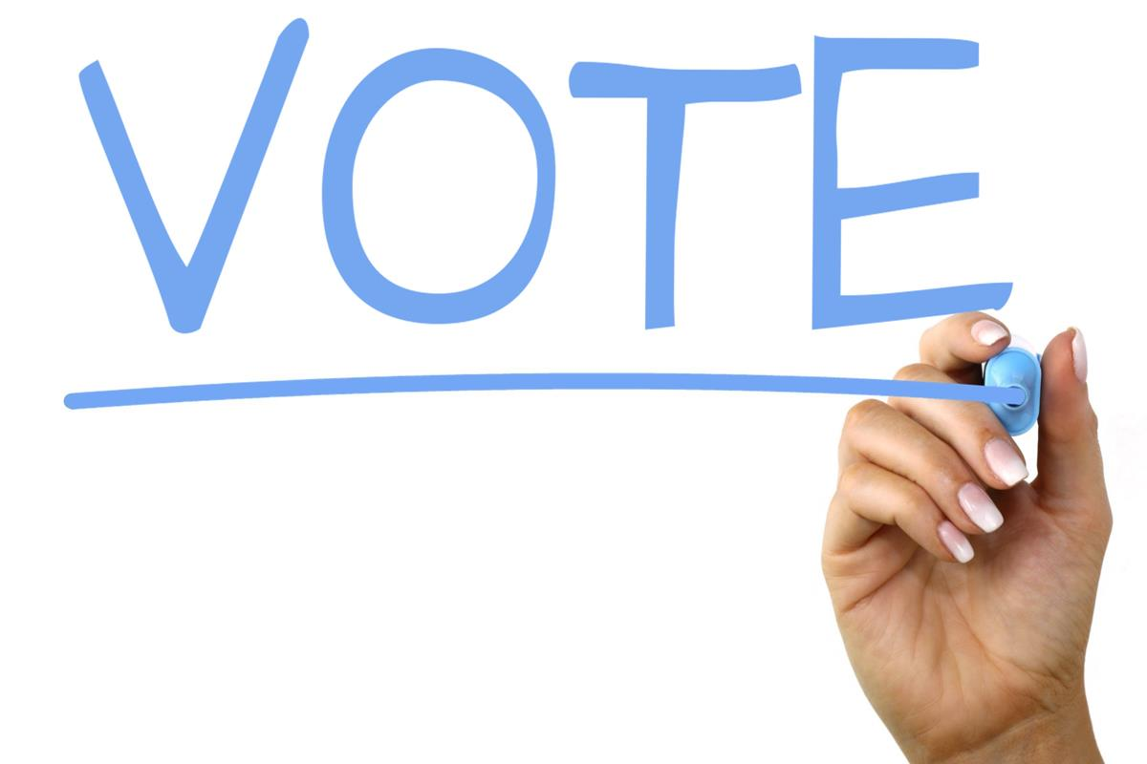
Objectives
First of all a single has the power to change the result of election so we have to make the voting machine with zero error
All vote should be counted and invisible for others
In this we are going to make our model which carries the candidate identity / Name and their symbols
we have to separated some functional part from main function which give us the quicker response
DEPARTMENT OF COMPUTER SCIENCE & ENGINEERING
SCHOOL OF ENGINEERING AND TECHNOLOGY, CUTM, BHUBANESWAR, ODISHA
Presented By: Mr. Name – Pratik kumar dash Registration No: 230301120095

Slide 6

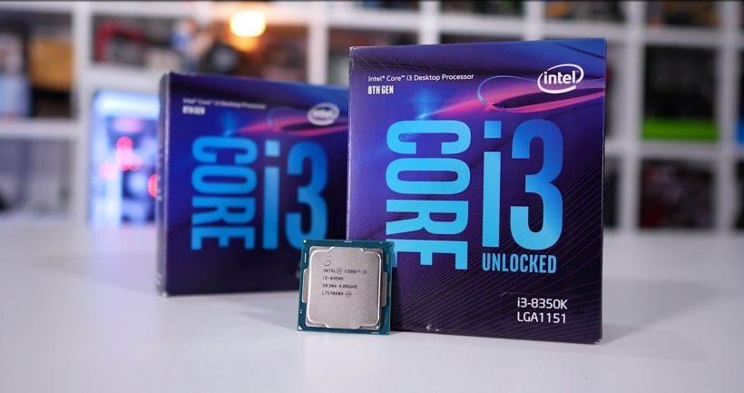
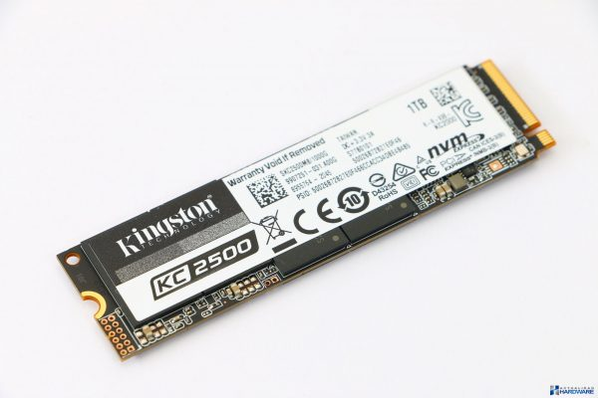
Hardware and Software Requirements
Hardware:
Devices
Processor - minimum 2.4 Gh intel i3 8th gen /Rygen 3450
Memory – 256gb NVME , SSD
Power Supply
Software:
Dev c++
Control panel
DEPARTMENT OF COMPUTER SCIENCE & ENGINEERING
SCHOOL OF ENGINEERING AND TECHNOLOGY, CUTM, BHUBANESWAR, ODISHA
Presented By: Mr. Name – Pratik kumar dash Registration No: 230301120095

Slide 7
Design(Logic Used)
Initialization
First we consider the algorithm of our model which based upon the voting machine using the accessible terminal
We separated the major segment part of the code to different function like – get votes and print votes
Get vote consist with input data that asking how much candidate should be there , how many voter include in this election , what are the symbols and getch() - ‘0’ which make particular stability of this system
Calculation:
Lets focusing the major part of voting system – printing vote function
In this function the input data are calculated with contain candidates total votes
Using if else condition we can determine there will be a winner or there is tie between the candidates
Body part
We put all the function to main functions by function calling and add some design the model to look cool in the terminal
DEPARTMENT OF COMPUTER SCIENCE & ENGINEERING
SCHOOL OF ENGINEERING AND TECHNOLOGY, CUTM, BHUBANESWAR, ODISHA
Presented By: Mr. Name – Pratik kumar dash Registration No: 230301120095

Slide 8
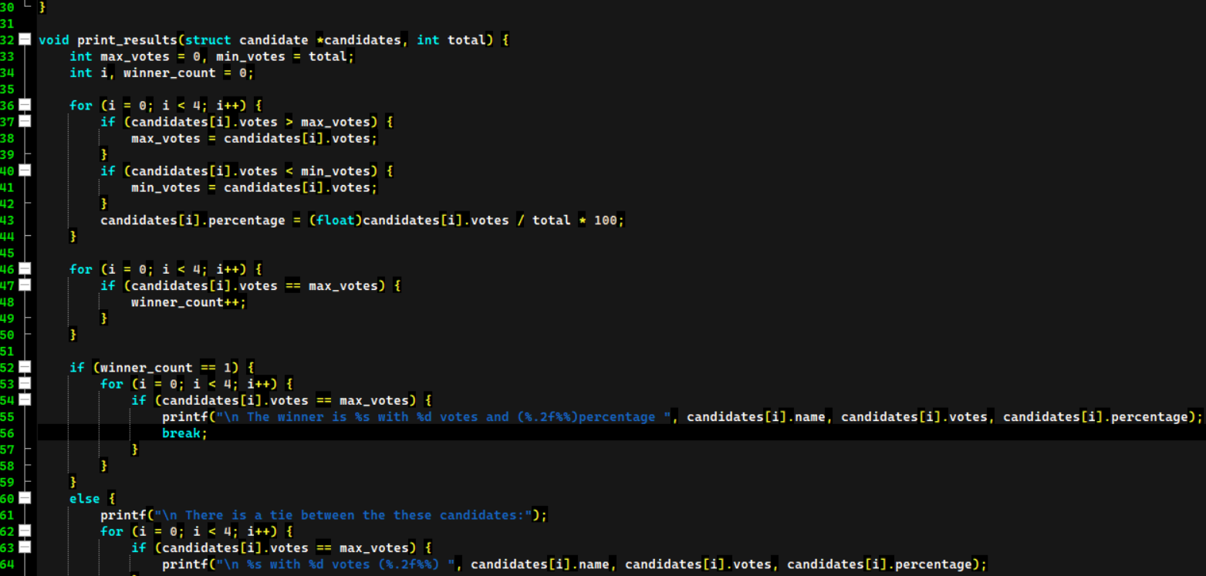
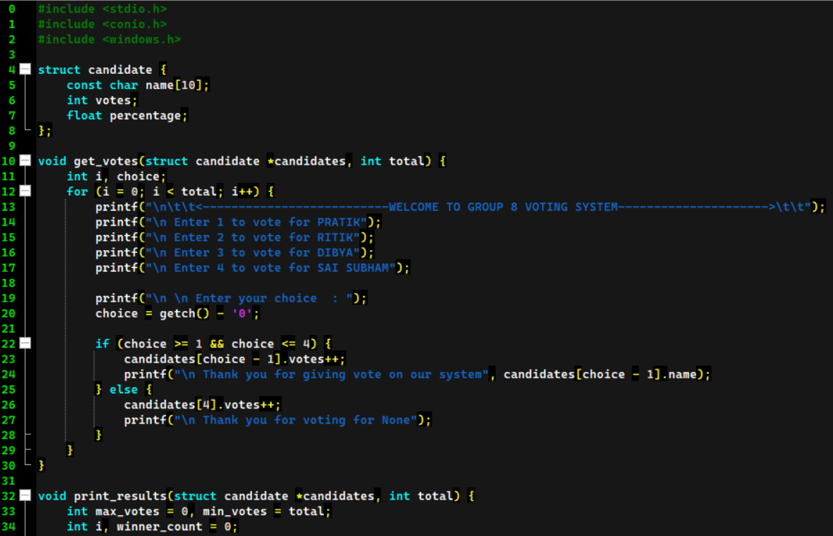
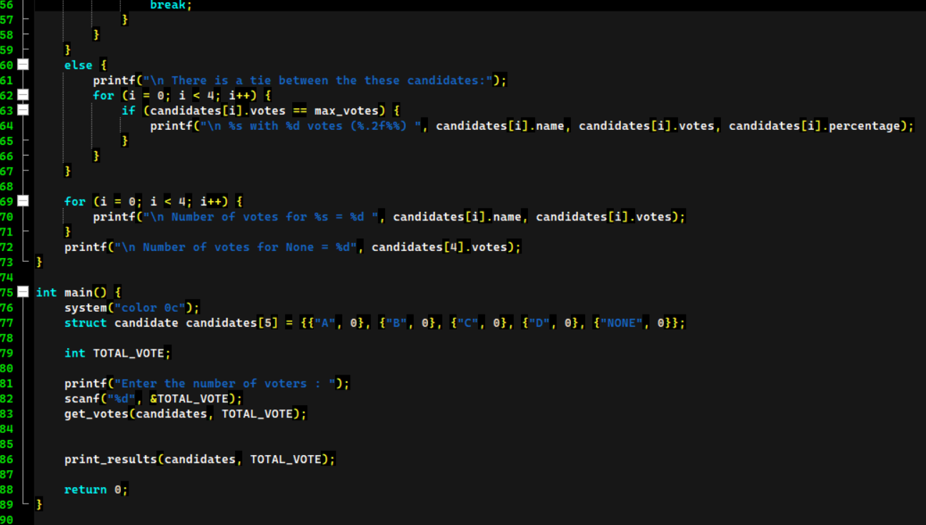
Code Samples
DEPARTMENT OF COMPUTER SCIENCE & ENGINEERING
SCHOOL OF ENGINEERING AND TECHNOLOGY, CUTM, BHUBANESWAR, ODISHA
Presented By: Mr. Name – Pratik kumar dash Registration No: 230301120095

Slide 9
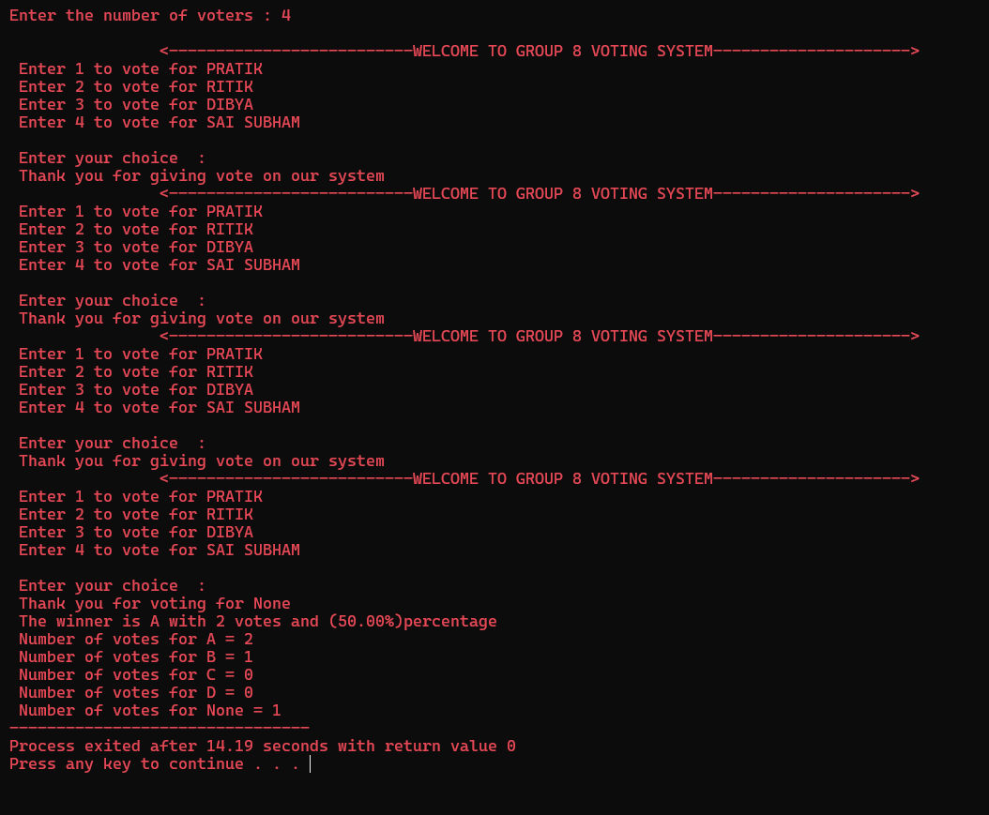
Result/Output (Snapshots)
Profits are up, and losses are down! We are very proud of the progress our team has made. Today we’ll review our wins and losses from last year and give you an overview of what you can expect for next year.
DEPARTMENT OF COMPUTER SCIENCE & ENGINEERING
SCHOOL OF ENGINEERING AND TECHNOLOGY, CUTM, BHUBANESWAR, ODISHA
Presented By: Mr. Name – Pratik kumar dash Registration No: 230301120095

Slide 10
Advantages and Limitations
Advantages:
EVMs make voting easier, more accurate, and faster. They're accessible to everyone, help prevent mistakes, and save time at polling stations. Plus, they make elections more secure and cost-effective.
Limitations:
But sometimes EVMs can have technical problems or be targeted by hackers, which can make people doubt their reliability. Not everyone has easy access to them, and some systems don't leave a paper trail, which can make it hard to check the results. We need to work on these issues to make sure EVMs are fair and trustworthy for everyone.
DEPARTMENT OF COMPUTER SCIENCE & ENGINEERING
SCHOOL OF ENGINEERING AND TECHNOLOGY, CUTM, BHUBANESWAR, ODISHA
Presented By: Mr. Name – Pratik kumar dash Registration No: 230301120095

Slide 11

Future Scope
Accuracy: EVMs can minimize errors in the voting process, reducing the likelihood of miscounts or tampering. By ensuring the accuracy of election results, trust in the democratic process can be strengthened.
Security: Future advancements in EVM technology can enhance security measures to prevent hacking or manipulation of election results. By implementing robust encryption and authentication protocols, EVMs can safeguard the integrity of elections.
Results: EVMs can enable the quick tabulation and reporting of election results, allowing for faster dissemination of information to the public and reducing uncertainty surrounding election outcomes.
Cost Efficiency: Over time, advancements in EVM technology could lead to cost savings for election authorities by streamlining the voting process and reducing the need for manual labor associated with traditional paper-based voting systems
DEPARTMENT OF COMPUTER SCIENCE & ENGINEERING
SCHOOL OF ENGINEERING AND TECHNOLOGY, CUTM, BHUBANESWAR, ODISHA
Presented By: Mr. Name – Pratik kumar dash Registration No: 230301120095

Slide 12


Conclusion
In simple terms, electronic voting machines (EVMs) have a bright future that could change how we participate in elections. They can make voting easier, more accurate, and more secure. Imagine being able to vote from home or quickly knowing the election results. With advancements like blockchain technology, EVMs could make elections fairer and more transparent. As we keep improving EVMs, voting could become a smoother and more reliable process for everyone.
DEPARTMENT OF COMPUTER SCIENCE & ENGINEERING
SCHOOL OF ENGINEERING AND TECHNOLOGY, CUTM, BHUBANESWAR, ODISHA
Presented By: Mr. Name – Pratik kumar dash Registration No: 230301120095

Slide 13

References
E. Balagurusamy
Faculty guidance
Google.com
Open ai
other recourses …..
DEPARTMENT OF COMPUTER SCIENCE & ENGINEERING
SCHOOL OF ENGINEERING AND TECHNOLOGY, CUTM, BHUBANESWAR, ODISHA
Presented By: Mr. Name – Pratik kumar dash Registration No: 230301120095
This Photo by Unknown Author is licensed under CC BY-NC

Slide 14

Any Query
DEPARTMENT OF COMPUTER SCIENCE & ENGINEERING
SCHOOL OF ENGINEERING AND TECHNOLOGY, CUTM, BHUBANESWAR, ODISHA

Slide 15

Thank you
Guided By: Mr. Satyananda Swain.
Asst. Prof., Department of CSE, CUTM, BBSR.
Presented By: PRATIK KUMAR DASH
Group No: 08
Mr. Name- PRATIK KUMAR DASH Registration No: 230301120095
Mr. Name- RITIKRUPAM NANDA Registration No: 230301120072
Mr. Name- SAI SUBHAM SAHOO Registration No: 230301120084
Mr. Name- DIBYAJYOTI SAHOO Registration No: 23030112078
DEPARTMENT OF COMPUTER SCIENCE & ENGINEERING
SCHOOL OF ENGINEERING AND TECHNOLOGY, CUTM, BHUBANESWAR, ODISHA

